Slide 1
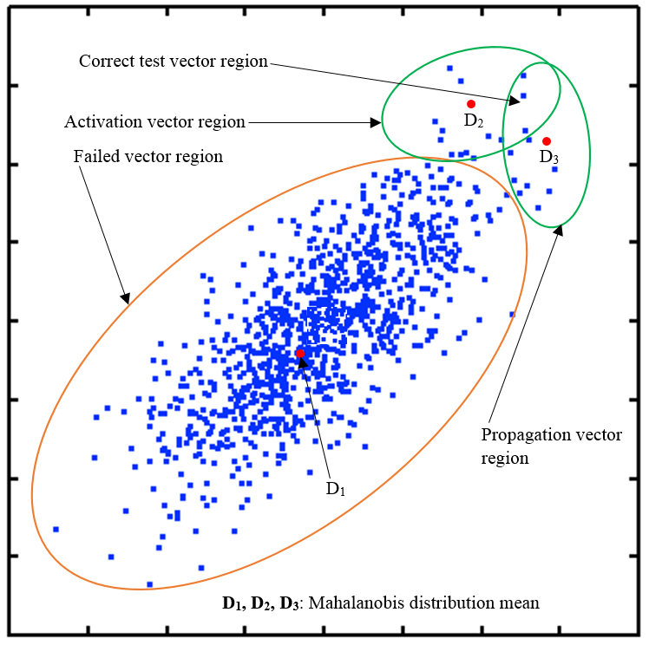
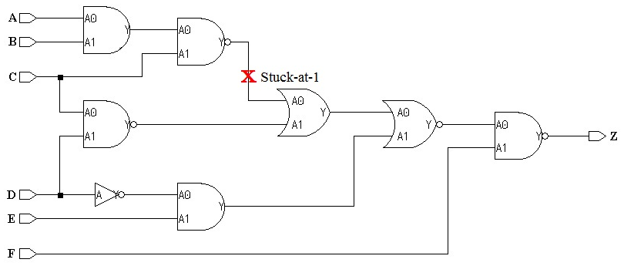
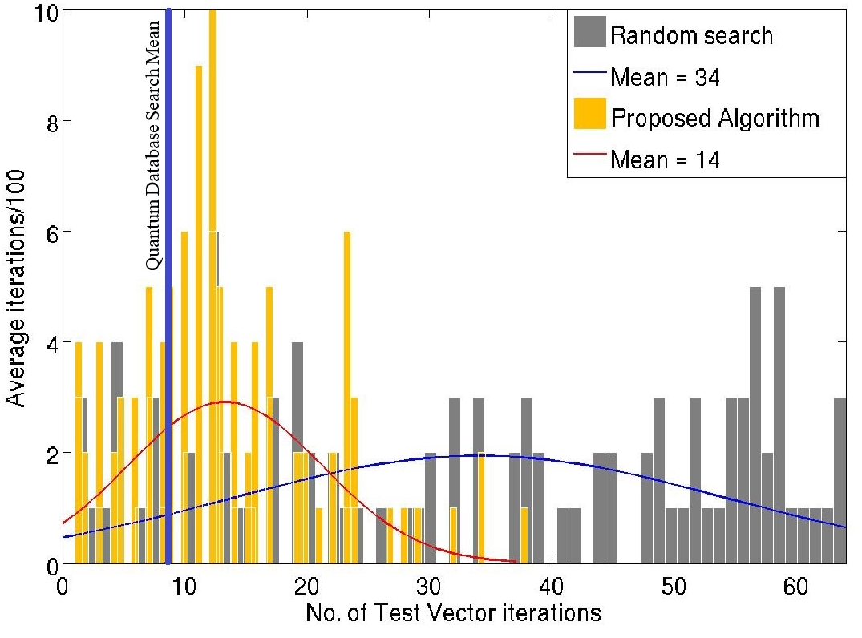
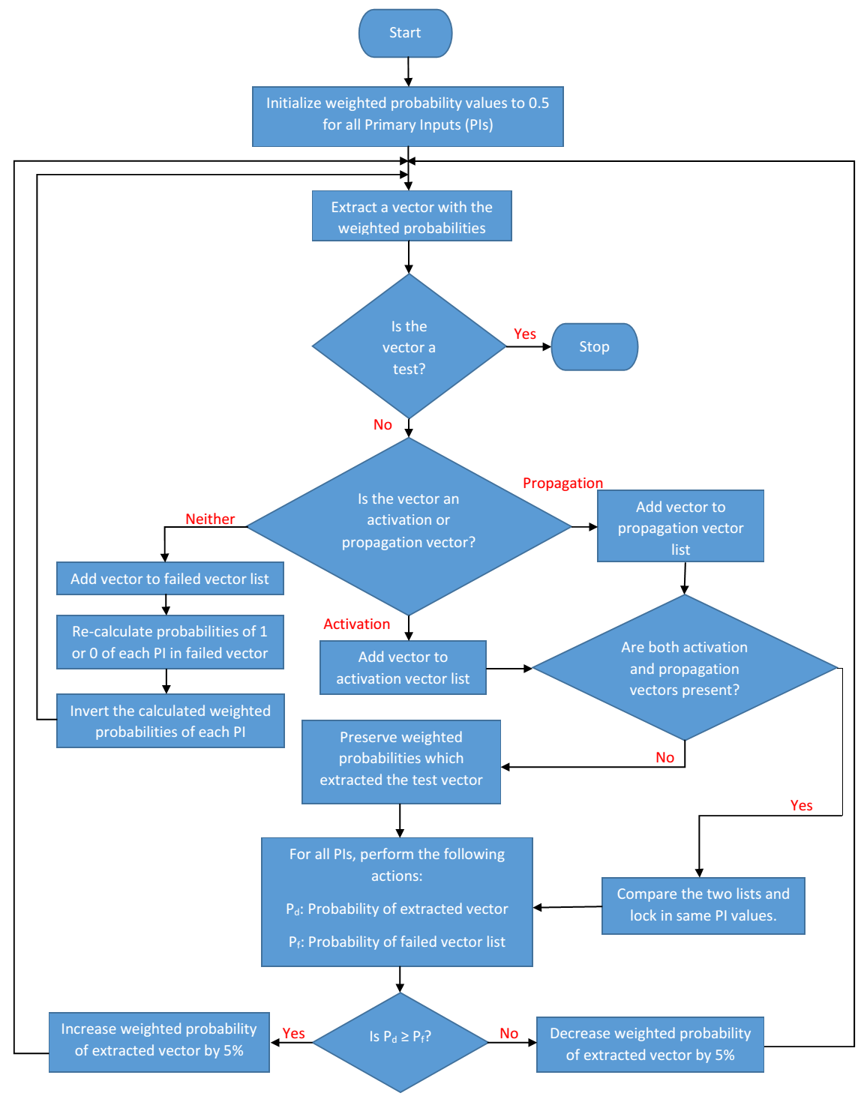
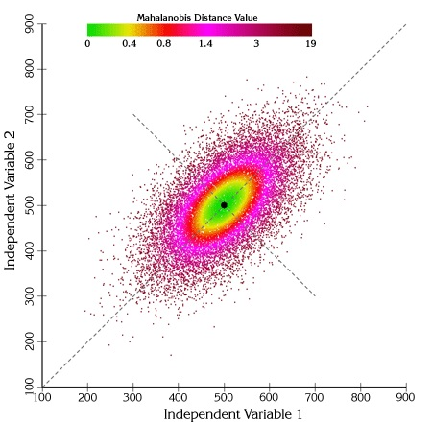
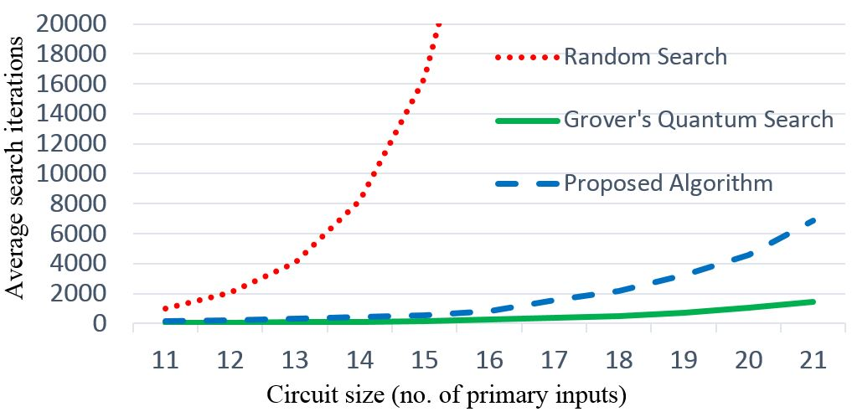
Failure Evasion: Statistically Solving the NP Complete Problem of Testing Difficult-to-Detect Faults
Murali Venkatasubramanian
Doctoral Candidate
Electrical and Computer Engineering
Vishwani D. Agrawal
James J. Danaher Professor
Electrical and Computer Engineering
Abstract
Implementation
Results
It is colloquially known that using a pure random test generator to test for faults in a digital circuit is horribly inefficient. To overcome this inefficiency, various testing algorithms were successfully developed and implemented over the last 50 years. Because searching for the last few faults which are hard to detect is mathematically NP complete, it can become computationally expensive to attain 100% fault coverage in a finite amount of time. Contemporary algorithms usually generate new test vectors based on properties of previous successful ones and hence enter a bottleneck when trying to find tests for these hard to detect stuck-at faults as their test properties may not match previous test successes.
We attempt to answer this question: “How to design a new test algorithm which utilizes the information from failed attempts effectively?” We hypothesize that avoiding the properties of failed vectors by learning from each failure would lead to the solution in quicker iterations. We use a statistical method to maximize the “Mahalanobis distance" from the failed vectors while simultaneously reducing the distance to “activation/propagation vectors". This poster elaborates on the meaning of Mahalanobis distance and how it is used to avoid generation of tests with properties of known failed vectors. We also provide extended results of our earlier version of this method by comparing our results with random search generator and quantum search for various benchmark circuits.
Activation vectors
Activate a desired stuck-at fault on circuit’s fault line.
Not all vectors may propagate the fault.
Propagation vectors
Sensitize the path to the primary outputs
Propagates a desired line’s fault to the primary output.
Failed vectors
Neither activate nor propagate a fault.
Objectives
Given a stuck-at fault, find a test.
Specifically, finding tests for hard to detect stuck-at faults.
Improve the bottleneck of finding the unique tests.
Use “Mahalanobis distance” metric to derive a new Automatic Test Pattern Generator (ATPG).
Mahalanobis Distance
It is a distance measure which can be used to find outliers in a dataset.
It is a powerful statistical technique which measure how similar or dissimilar are a set of conditions to an sample set.
Takes into account the covariance between the variables.
In a multi-dimensional sense, it measures how many standard deviations is a point P away from a distribution D.
The general equation is given as:
Conclusion
http://www.jennessent.com/arcview/mahalanobis description.htm/
Utilizes the statistical method of “Mahalanobis distance" to find tests for the last few difficult to detect stuck-at faults.
Promises of better and more efficient implementations underway.
Previous work extended to larger and more complex benchmark circuits and resilience shown with increasing circuit complexity.
Run simulations on more benchmark circuits.
$$D= \sqrt{{(x−μ)}^{T} S^{−1}(x−μ)}$$
where
x = Vector of data μ = Vector of mean values of independent variables S⁻¹ = Inverse covariance matrix
[Mahalanobis, 1936] P. C. Mahalanobis, “On the Generalized Distance in Statistics,” Proceedings of the National Institute of Sciences (Calcutta), vol. 2, pp. 49–55, 1936.
[Venkatasubramanian and Agrawal, 2015] M. Venkatasubramanian and V. D. Agrawal, “Quest for a Quantum Search Algorithm for Testing Stuck-at Faults in Digital Circuits,” in Proc. 29th IEEE International Symp. Defect and Fault Tolerance in VLSI and Nanotechnology Systems, Amherst, MA, 2015, pp. 128–133.
[Grover, 1996] L. K. Grover, “A Fast Quantum Mechanical Algorithm for Database Search,” in Proc. 28th Annual ACM Symp. Theory of Computing, 1996, pp. 212–219.

